Slide 1

1
Project Management Concepts
Notes:
(Premium)
Teaching Strategies
Let the students know that this course is not only for project managers. Anyone who is involved in working on a project will benefit from this course.
Stress to them that what makes projects successful are the people involved. In order for this class to be successful they must be involved actively.
Encourage all students to participate by asking them to identify different projects in which they have been involved.
For each project ask them what the objective was, what the constraints were, what the schedule was, and what resources were used.
Ask them if they can identify any project managers in the real world. If they get stuck, give them some hints. For example, have them think about sports or music, or some other area of interest.
Ask your students to discuss something they did during the past summer or winter break, such as take a vacation, go to a concert, or watch a play.
Ask them how those activities relate to project management.
The Internet exercises in this chapter are very important. They involve having students peruse the Project Management Institute’s website.
Since it was founded in 1969, the Project Management Institute (PMI) membership is approaching 500,000 members in nearly 200 countries and has about 270 chapters in more than 80 countries.
Pennsylvania-based PMI is, by far, the leading nonprofit professional association in the area of project management. It establishes standards, sponsors seminars, develops educational programs, has a professional certification program, and publishes Project Management Journal and PM Network.
It has an excellent website for project management. The students can have some fun with this site.
Optional Supplemental Activities
Have students contact a local not-for-profit organization in your community. Tell them that they are interested in learning about their operations. Ask them to describe a project that they are currently working on. What is the objective? The constraints? The resources? The budget? The schedule? If possible, have teams contribute a few hours to the project. Through this process they will be helping someone in need and learn about a real-world project at the same time. Have each group prepare a report that summarizes the project and what they learned from this experience. Give students about three weeks for this effort
Have a project manager be a guest lecturer in class to present the benefits of project management techniques. If the project manager has had international experience, have the project manager discuss the complexity of managing an international project.

Slide 2
Chapter Concepts
Definition of a project and its attributes
Key constraints within which a project must be managed
Life cycle of a project
Definition of project management
Elements of the project management process
Identification and engagement of stakeholders
Implications of global project management
Project Management Institute
Benefits of project management
Notes:
Chapter Concepts
This chapter presents an overview of project management concepts. This chapter will help students to become familiar with the following concepts:
Definition of a project and its attributes
Key constraints within which a project must be managed
Life cycle of a project
Definition of project management
Elements of the project management process
Identification and engagement of stakeholders
Implications of global project management
Project Management Institute
Benefits of project management

Slide 3
Learning Outcomes
Define what a project is
List and discuss the attributes of a project
Explain what is meant by project objective
Define what is meant by project deliverable
Provide examples of projects
Discuss project constraints
Describe the phases of the project life cycle
Define and apply project management
Discuss the steps of the planning process
Identify the three elements of the executing process
Create a stakeholder register
Discuss stakeholder engagement
Discuss some implications of global project management
Discuss the Project Management Institute
List benefits of project management techniques
Notes:
Learning Outcomes
After studying this chapter, students should be able to:
Define what a project is
List and discuss the attributes of a project
Explain what is meant by project objective
Define what is meant by project deliverable
Provide examples of projects
Discuss project constraints
Describe the phases of the project life cycle
Define and apply project management
Discuss the steps of the planning process
Identify the three elements of the executing process
Create a stakeholder register
Discuss stakeholder engagement
Discuss some implications of global project management
Discuss the Project Management Institute
List benefits of project management techniques

Slide 4
Project Integration Management
Project Management Knowledge Areas from PMBOK® Guide
Notes:
Project Management Knowledge Areas from PMBOK® Guide
Concepts in this chapter support the following Project Management Knowledge Areas of the PMI Guide to the Project Management Body of Knowledge (PMBOK® Guide):
Project Integration Management
Project Stakeholder Management

Slide 5

Managing Culture for Project Success
Background
Findings
Culture is a way of thinking
  Culture of innovation
  Behavior and attitudes
  Actions
    Assertiveness
    Collectivism
    Humane orientation
  National cultural practices
    Austria
    Canada
    Finland
    South Korea
Assertiveness is linked to encouragement for taking initiatives and rewards for performance
Collectivists expressed pride, loyalty, and cohesiveness with others in their group or organization
Humane orientation encouraged or rewarded others for their fairness, generosity, care, and kindness
Notes:
Vignette A: Managing Culture for Project Success
Culture is a way of thinking that distinguishes one group of people from other groups of people. An organization’s culture of innovation is the support for new ideas, risk, and failure. Behavior and attitudes are influenced by culture. Actions such as assertiveness, collectivism, or humane orientation can be defined for different cultures and influence how a project manager makes decisions related to managing a project and project team members.
The story presented in this first vignette is based on a research study of project members in four countries, Austria, Canada, Finland, and South Korea. The characters are created based upon the findings of the study.
Many companies have offered professional development on understanding diversity and culture to learn about corporate innovation culture and its relationship with assertiveness, collectivism, and humane orientation.
Cross-cultural management can be influenced by managerial practices and other organizational factors. Innovation activities often include championing programs, incentives for initiating new ideas, and monetary and nonmonetary rewards.
Companies with a high innovation culture also had workers who showed high levels of analytical behaviors and a high problem-solving orientation.
A survey was implemented to learn more about the teams in each of the countries related to assertiveness, collectivism, and humane orientation, the three factors most related to changes in corporate innovation culture..
Assertiveness had been found to be linked to encouragement for taking initiatives and rewards for performance.
Collectivists expressed pride, loyalty, and cohesiveness with others in their group or organization.
Those with a humane orientation encouraged or rewarded others for their fairness, generosity, care, and kindness
The findings of the survey indicated that the teams in the four countries were different from each other. Respondents from the countries were found to have the following characteristics.
Austria had the highest scores in assertiveness and Finland had the lowest
South Korea had the highest score for collectivism and Finland had the lowest
Canada had the highest humane orientation score and Austria had the lowest
Corporate culture should be compatible with national cultural practices to increase the potential for project success

Slide 6
Project Management Promising for Productivity Increases
Wanted to Know
Five Year Study
Characteristics and factors related to project management
Affect on small to medium-sized businesses and their success
Production increase due to project management skills and other factors
Spend 10% or higher of budget on marketing
PM as core business process reported higher productivity
PM had greater impact than other factors
Notes:
Vignette B: Project Management Promising for Productivity Increases
Small to medium-sized businesses have been found to make up between 70% and 90% of the enterprises in the Organisation for Economic Co-operation and Development, an organization of 39 countries from around the world who account for 80% of world trade. In Australia, more than 90% of all businesses were small to medium-sized companies who employed the majority of the people who work. The evidence from the findings also indicates that investing in project management has the potential for a greater improvement in productivity compared to investing in business management; thus, it is suggested that the companies should hire fewer people with an MBA and more with an equivalent degree or experience in project management.
A team in the Australian Bureau of Statistics Research wanted to know about the characteristics and factors related to project management that affected small to medium-sized businesses and their success.
They collected data over a five-year period.
15% more of the companies who reported using project management techniques also reported an increase in productivity compared to those companies who did not use project management.
This was not sufficient evidence to support the claim that project management leads to greater productivity.
Determine if project management skills were more important than skills related to engineering, scientific and research, IT professionals, IT support technicians, trades, transport, plant and machinery operation, marketing, business management, or financial.
Findings
first outcome found that about 68.9% of production increase was due to skills in project management, scientific and research, IT professionals, trades, marketing, and financial
Second outcome found that about 69.4% of production increase was due to skills in project management, scientific and research, IT professionals, plant and machinery operation, marketing, and financial
Further analysis of the two results indicated that organizations usually spend 10% or higher of their budget on marketing
Calculated what would happen if the budgets for marketing and project management were balanced. Determined that project management was a viable option for increasing productivity.
Companies that used project management for core business processes were more likely to report an increase in productivity compared to companies who reported their productivity stayed the same.
The use of project management had a greater impact on increased productivity than using IT professionals, marketing skills, scientific and research skills, and financial skills.

Slide 7
Project Attributes
Clear objective
Series of interdependent tasks
Various resources
Specific time frame
Unique, one-time endeavor
Sponsor or customer
Degree of uncertainty
Notes:
Project Attributes
A project is an endeavor to accomplish a specific objective through a unique set of interrelated tasks and the effective utilization of resources. The following attributes help define a project:
A project has a clear objective that establishes what is to be accomplished. It is the tangible end product that the project team must produce and deliver. The project objective is usually defined in terms of end product or deliverable, schedule, and budget. Furthermore, it is expected that the work scope will be accomplished in a quality manner and to the customer’s satisfaction.
A project is carried out through a series of interdependent tasks in a certain sequence in order to achieve the project objective.
A project utilizes various resources to carry out the tasks.
A project has a specific time frame, or finite life span - a start time and a date by which the objective must be accomplished.
A project may be a unique or one-time endeavor such as developing a new product, building a house, or planning a wedding.
A project has a sponsor or customer that provides the funds necessary to accomplish the project. In a business setting, the customer can be internal or external to your organization.
Finally, a project involves a degree of uncertainty and is based on certain assumptions and estimates for the project budget, schedule, and work scope.

Slide 8
List examples of projects
Student Discussion
Notes:
Get your students to list as many examples of real projects as they can. For each example listed, discuss some of the project attributes.

Slide 9
Possible responses to Student Discussion
Staging a theatrical production
Developing and introducing a new product
Developing a set of Apps for mobile business transactions
Planning a wedding
Modernizing a factory
Designing and implementing a computer system
Converting a basement to a family room
Organizing and hosting a conference
Designing and producing a brochure
Executing an environmental cleanup of a contaminated site
Holding a high school reunion
Building a shopping mall
Performing a series of surgeries on an accident victim
Organizing a community festival
Consolidating two manufacturing plants
Rebuilding a town after a natural disaster
Hosting a dinner for 20 relatives
Designing a business internship program for high school students
Building a tree house
List examples of projects
Notes:
Get your students to list as many examples of real projects as they can. For each example listed, discuss some of the project attributes. Some examples are:
Staging a theatrical production
Developing and introducing a new product
Developing a set of Apps for mobile business transactions
Planning a wedding
Designing and implementing a computer system
Issuing a new $1.00 coin
Modernizing a factory
Converting a basement to a family room
Organizing and hosting a conference
Designing and producing a brochure
Executing an environmental cleanup of a contaminated site
Holding a high school reunion
Building a shopping mall
Performing a series of surgeries on an accident victim
Organizing a community festival
Consolidating two manufacturing plants
Rebuilding a town after a natural disaster
Hosting a dinner for 20 relatives
Designing a business internship program for high school students
Building a tree house

Slide 10
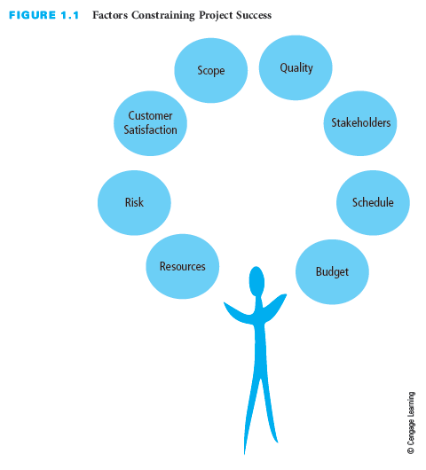
Balancing Project Constraints
Notes:
Balancing Project Constraints
The successful accomplishment of the project objective is usually constrained by many factors, including scope, quality, schedule, budget, resources, risks, and customer satisfaction.
Various resources are needed to perform the project tasks and accomplish the project objective. Resources include people, materials, equipment, facilities, and so on.
Risks adversely affect accomplishing the project objective.
Customer satisfaction goes beyond just completing the project scope within budget and on schedule or asking if the customer is satisfied at the end of the project. It means not only meeting the customer’s expectations but also developing and maintaining an excellent working relationship throughout the project.
Project scope is all the work that must be done in order to produce the project deliverables (the tangible product or items to be provided), satisfy the customer that the deliverables meet the requirements or acceptance criteria, and accomplish the project objective.
Quality expectations must be defined from the onset of the project. The project work scope must be accomplished in a quality manner and meet specifications.
The schedule for a project is the timetable that specifies when each task or activity should start and finish. The project objective usually states the time by which the project scope must be completed in terms of a specific date agreed upon by the sponsor and the organization performing the project.
The budget of a project is the amount the sponsor or customer has agreed to pay for acceptable project deliverables. The project budget is based on estimated costs associated with the quantities of various resources that will be used to perform the project.
During the project, it is sometimes challenging to balance these factors, which often constrain one another and can jeopardize accomplishing the project objective. To help assure the achievement of the project objective, it is important to develop a plan before starting the project work rather than starting without a plan. Lack of a plan decreases the chances of successfully accomplishing the full project scope within budget and on schedule.

Slide 11
List unforeseen circumstances that jeopardize the project with respect to:
Scope
Cost
Schedule
Student Discussion
Notes:
Once a project is started, unforeseen circumstances may occur that jeopardize the achievement of the project objective with respect to scope, cost, or schedule. Have students list examples of unforeseen circumstances.

Slide 12
Possible responses to Student Discussion
Costs are more than estimated
Inclement weather
Additional redesign
Modifications
Delivery of critical components is delayed
Key project team member leaves the project
List unforeseen circumstances that jeopardize the project with respect to
  Scope
  Cost
  Schedule
Notes:
Some examples of unforeseen circumstances are:
The cost of some of the materials is more than originally estimated.
Inclement weather causes a delay.
Additional redesign and modifications to a new sophisticated medical instrument are required to get it to meet the performance specifications and meet government testing requirements.
Delivery of a critical component for an aviation control system is delayed several months.
A key project team member with unique technical knowledge decides to retire, which creates a gap in critical expertise.
Students can be creative and encourage them to list any others they think of.

Slide 13
Project Manager Actions
Prevent, anticipate, overcome
Have good planning and communication
Be responsible
Notes:
Project Manager Actions
The project manager must perform a number of actions throughout the duration of a project.
Prevent, anticipate, and/or overcome problems and limitations in order to complete the project scope on schedule, within budget, and to the customer’s satisfaction.
Have good planning and communication – they are essential to preventing problems from occurring and to minimize their impact.
Be responsible to make sure the customer is satisfied. This goes beyond merely completing the project within budget and on schedule. It requires ongoing communication with the customer.

Slide 14
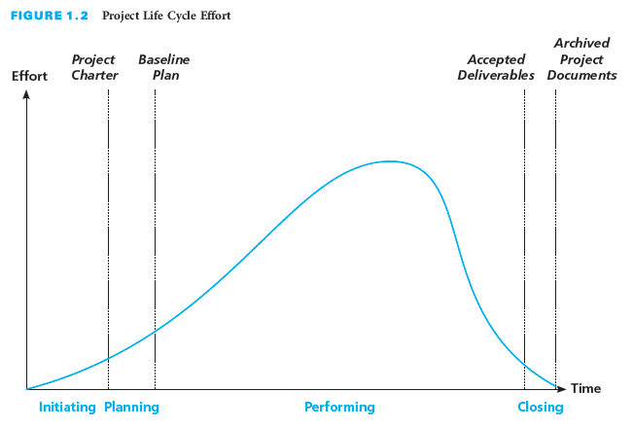
The Project Life Cycle
Notes:
The Project Life Cycle
The project life cycle has four general phases: initiating, planning, performing, and closing the project, which you can see in the figure on this slide.
The time span of each phase and the associated level of effort will vary depending on the specific project.
Project life cycles can vary in length from a few weeks to several years, depending on the content, complexity, and magnitude of the project in question.

Slide 15
Initiating Phase
First phase
Identify need, problem, or opportunity
Determine if select project
Develop project charter
  Rationale
  Project objective
  Expected benefits
  General requirements and conditions
Decide if RFP needed
Notes:
Initiating Phase
In the initiating phase, projects are identified and selected and then authorized using a document referred to as a project charter.
The first phase of the project life cycle:
Involves the identification of a need, problem, or opportunity and can result in the sponsor authorizing a project to address the identified need or solve the problem
May take several months to identify the need, gather data, and define the project objective
It is very important to define the right need. Needs are often defined as part of an organization's strategic planning process.
Organizations must have a project selection process to determine what projects to pursue
The project charter includes:
Rationale, or justification, for the project
Project objective and expected benefits
General requirements and conditions such as amount of funds authorized, required completion date, major deliverables, and required reviews and approvals; and key assumptions
If it decides to use external resources, an organization develops a request for proposals, or RFP, asking contractors to submit proposals describing how to address the need, associated costs, and schedule.

Slide 16
Planning Phase
Second Phase
Show how project scope will be accomplished
Plan the work and work the plan
Develop baseline plan
  What needs to be done -- scope, deliverable
  How it will get done -- activities, sequence
  Who will do it -- resources, responsibilities
  How long it will take -- durations, schedule
  How much it will cost -- budget
  What the risks are
Have actual resources plan the work
Notes:
Planning Phase
The planning phase is the second phase of the project life cycle, It includes defining the project scope, identifying resources, developing a schedule and budget, and identifying risks, all of which make up the baseline plan for doing the project work.
Shows how the project scope will be accomplished within budget and on schedule
Plan the work and work the plan
The detailed plan results in a baseline plan
What needs to be done— scope, deliverable
How it will get done– activities, sequence
Who will do it– resources, responsibilities
How long it will take– durations, schedule
How much it will cost— budget
What the risks are
Benchmark the baseline plan to allow for comparison with actual progress.
Include the people that will actually do the work in the planning process.
They have knowledge of detailed activities to be done.
Participation also builds commitment.

Slide 17
Performing Phase
Third phase
Accomplish project objectives
  Project manager leads
  Project team completes the project
Increase pace as more resources are added
Monitor and control progress
Take corrective action as needed
Manage and control changes with sponsor approval
Achieve customer satisfaction with acceptance of deliverable
Notes:
Performing Phase
In the performing phase, the project plan is executed and work tasks are carried out to produce all the project deliverables and to accomplish the project objective.
The project progress is monitored and controlled to assure the work remains on schedule and within budget, the scope is fully completed according to specifications, and all deliverables meet acceptance criteria.
Any changes need to be documented, approved, and may be incorporated into an updated baseline plan.
This is the third phase of the project life cycle.
The project manager leads the project team to complete the project.
The pace of the project increases as more and various resources are involved in the project.
It is necessary to monitor and control the project's progress by comparing accomplishments to the baseline plan.
Corrective actions are taken if a project is off track.
Changes are managed and controlled through documentation, approval, and communication with agreement between the sponsor and the contractor.
Some change is trivial
The end of the phase, customer satisfaction, is achieved when the work and deliverables are accepted by the customer and the project objective is accomplished.
Several alternative actions may be evaluated to determine the best approach to bring the project back within the scope, schedule, and budget constraints of the project.
Determine if any sacrifices to scope, budget, schedule, or quality are necessary to accomplish the project.
The costs of changes vary with the timing in the project– generally, the later in the project that changes are identified, the greater their effect on accomplishing the project objective.

Slide 18
Closing Phase
Final phase
Collect and make final payments
Recognize and evaluate staff
Conduct post project evaluation
Document lessons learned
Archive project documents
Record lessons learned
Notes:
Closing Phase
In the closing phase, project evaluations are conducted, lessons learned are identified and documented to help improve performance on future projects, and project documents are organized and archived.
This is the final phase of the project life cycle
It includes a variety of actions such as:
Collecting and making final payments
Staff recognition and evaluation
Conducting a post project evaluation
Documenting lessons learned
Archiving project documents
Using a knowledge base to record lessons learned and post-project evaluation
A knowledge base is helpful to retrieve the lessons and information that can help with doing business with the customer or other customers in the future.

Slide 19
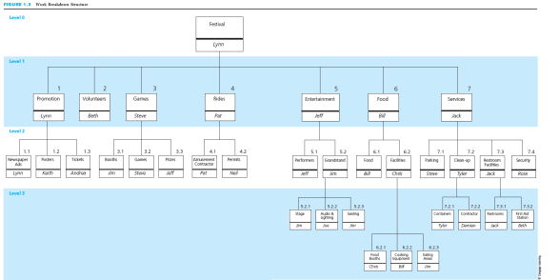
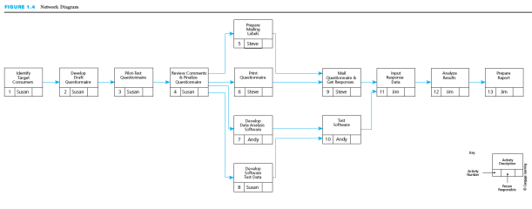
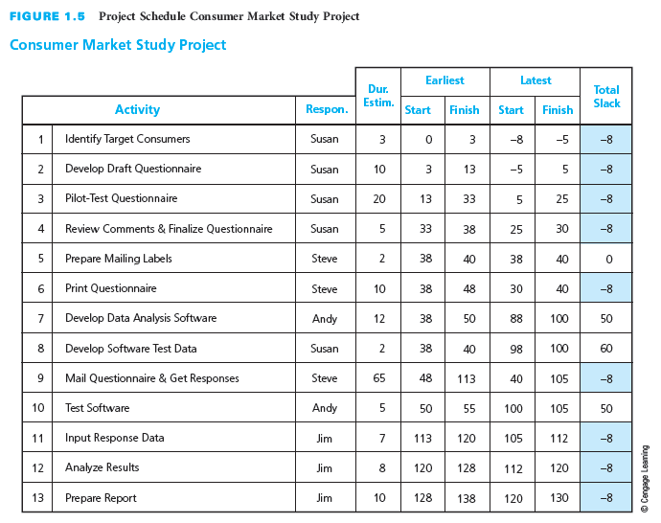
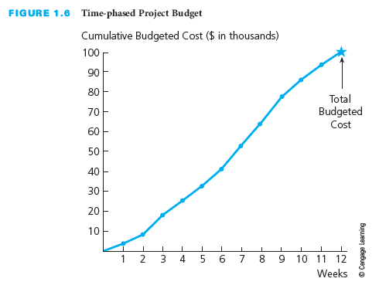
Project Planning Process
Establish project objective
Define scope
Create WBS
Assign responsibility
Define specific activities
Sequence activities
Estimate activity resources
Estimate activity durations
Develop project schedule
Estimate activity costs
Determine budget
Notes:
Project Planning Process
Project management is planning, organizing, coordinating, leading, and controlling resources to accomplish the project objective. The project management process involves planning the work (establishing the plan) and then working the plan (executing that plan).
There are many steps in the project planning process, as you can see on this slide.
Establish project objective– agreed upon by sponsor and contractor
Define scope– includes customer requirements, defines major work tasks, lists deliverables and associated acceptance criteria
Create a work breakdown structure, or WBS– a hierarchical decomposition of the project scope into work elements to be executed by the project team and produce the project deliverables
Assign responsibility–the person or organization responsible for each work item is identified
Define specific activities– develop a list of detailed activities needed to perform each work package and produce any required documents
Sequence activities–create a network diagram that shows the necessary sequence and dependent relationships
Estimate activity resources–determine the types of resources needed for each activity. These may include people, materials, or equipment that are internal or external to the contractor.
Estimate activity durations– time estimates for how long each activity will take to be completed based on the estimate of resources available applied to each activity
Develop project schedule– determine the start and finish times for each activity to complete the project by its required completion date
Estimate activity costs– use the appropriate labor cost or unit cost rate for each type of resource to determine the cost of each activity
Determine budget– aggregate the costs associated with each activity and each work package and add indirect costs and profits to determine the costs of completing the project. Allocate the costs over time to determine the time-phased budget.

Slide 20
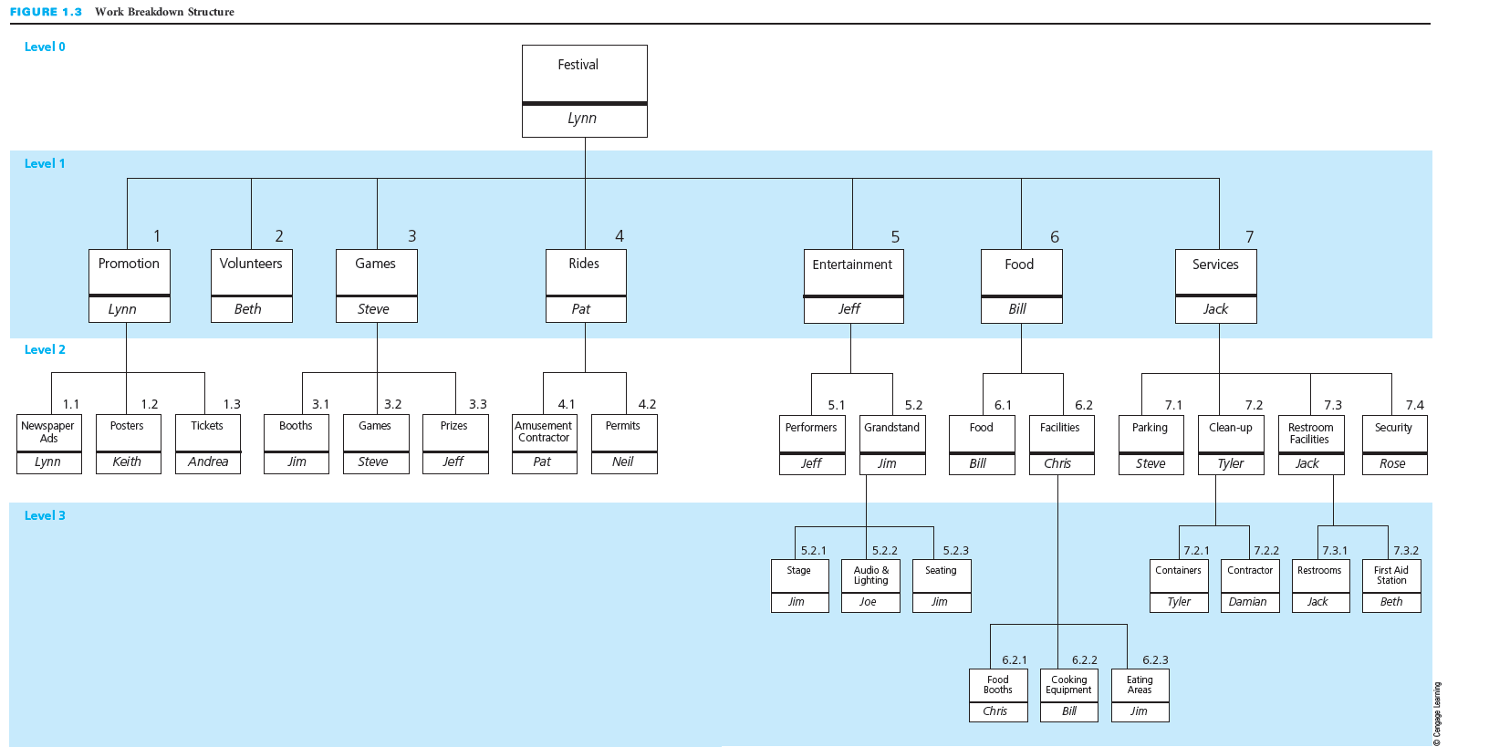
Create WBS and Assign Responsibility
Notes:
Create WBS and Assign Responsibility
A work breakdown structure, or WBS, is a hierarchical decomposition of the project scope into work elements to be executed by the project team and produce the project deliverables.
You can see a WBS in this slide.
Assigning responsibility involves determining who will be the person or organization responsible for each work item in the WBS.

Slide 21
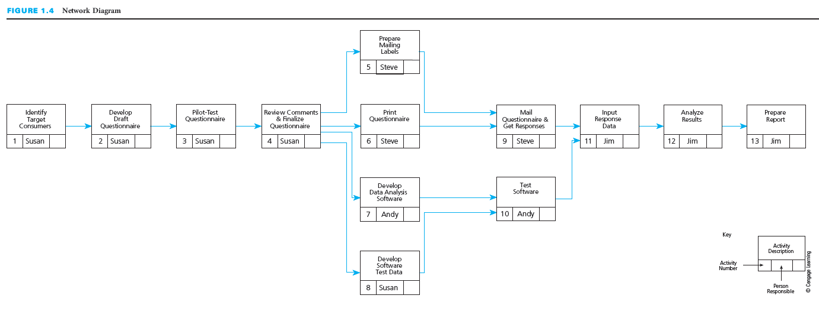
Sequence Activities
Notes:
Sequence Activities
The figure on this slide shows a network diagram that reveals the sequence of activities for a project.
Sequencing activities involves creating a network diagram that shows the necessary sequence and dependent relationships in a project.

Slide 22
Develop the Project Schedule
Notes:
Develop the Project Schedule
This table shows the project schedule for a consumer market study project.
Developing project schedule involves determining the start and finish times for each activity in order to complete the project by its required completion date.

Slide 23
Determine Budget
Notes:
Determine Budget
Here we see a time-phased project budget.
Determining the budget involves aggregating all the costs associated with each activity and each work package and adding indirect costs and profits to determine the costs of completing the project.
Allocate the costs over time to determine the time-phased project budget.

Slide 24
Why is it critical to develop a baseline plan for a project?
Student Discussion
Notes:
The result of the planning process is a baseline plan. Taking the time to develop a well thought out plan is critical to the successful accomplishment of any project. A baseline plan is highly important for keeping a project on track.
Why is it critical to develop a baseline plan for a project?

Slide 25
Possible responses to Student Discussion
Many projects overrun their budgets or miss completion dates
A baseline plan helps to compare progress
The graphical or tabular display shows the start and finish dates for each activity
The amounts of resources are known
The budget is displayed for each time period and the project
Why is it critical to develop a baseline plan?
Notes:
Why is it critical to develop a baseline plan?
Many projects overrun their budgets, miss their completion dates, or only partially met their requirements because there was no viable baseline plan before the project was started
A baseline plan helps to compare projects to initial benchmarks
The baseline plan for a project can be displayed in graphical or tabular format for each time period (week, month) from the start of the project to its completion. It shows the start and completion dates for each activity.
It helps to establish and display the amounts of the various resources that will be needed during each time period of a project
It shows the budget for each time period as well as the cumulative budget from the start of the project and for each time period

Slide 26
Execute the Project Plan
Perform the work
Monitor and control progress
Control changes
Notes:
Execute the Project Plan
Once a baseline plan has been established, the plan must be executed. The executing process involves performing the work according to the plan, monitoring and controlling the work, and controlling for changes so that the project scope is achieved within the budget and schedule, to the customer’s satisfaction.
Perform the work— all activities are performed to produce the deliverables and meet their acceptance criteria with regular communication with stakeholders and the customers
Monitor and control progress– regularly monitor the project to see if progress is going according to plan, measure the actual progress, and take corrective action if activities are behind schedule
Control changes— change to the work activities and to the project scope will occur for a variety of reasons. Changes need to be agreed upon by the sponsor and the contractor.

Slide 27
Stakeholder Engagement
Who are Stakeholders?
What to Create
Customer/sponsor
Project team including subcontractors and suppliers
Organizations or groups
  Supportive or adversarial
  Want to be kept informed because of potential impact
Stakeholder register
  Created as identify stakeholders
  Include
    Key contact information
    Role or specific topics of interest
    Expectations
    Any known issues
    Areas of potential influence
Issue log
Notes:
6. Stakeholder Engagement
Project stakeholders are individuals and entities involved in, or who may influence, or may be affected by a project, such as the customer/sponsor; project team, including the project manager, subcontractors, and consultants; end users or consumers; and advocacy groups.
Stakeholders include
Customer/sponsor and the project team including subcontractors and suppliers
Organizations or groups of people who may be supportive or adversarial or may want to be kept informed about the project because of potential impact
Create a stakeholder register as potential stakeholders are identified and include key contact information, role or specific topics of interest, expectations, any known issues, and areas of potential influence for each stakeholder.
Maintain in issue log of specific issues or concerns or questions that various stakeholders identify so that the project manager, project team, or sponsor/customer can address them and make sure they are not forgotten or dismissed without an adequate follow up and response.

Slide 28
Global Project Management
Globalization
Helpful Competencies
Adds a dimension of complexity
Changes project dynamics
Requires awareness of factors
  Cultural differences
  Currency
  Codes and regulations
  Business organization
  Political relations
  Workforce availability
Foreign language skills
Knowledge of
  Cultures
  Geography
  World history and contemporary events
  International economics
Awareness of
  Customs and etiquette
  Geopolitical environment
Technology adoption and translation software
Notes:
Global Project Management
Globalization adds a unique dimension to managing projects.
It changes the dynamics of the project and adds a layer of complexity that can adversely affect the project outcome if the project participants are not aware of what they might encounter regarding cultural differences and multinational economic transactions.
Different factors can create a dynamic, and even unstable environment, over the life of a project and include:
Cultural differences
Currency fluctuations and exchange rates
Country-specific work codes and regulations, such as hours per day, holidays, and religious observances
Corporate joint ventures and partnerships create entities with a presence and facilities in multiple countries and can make international business more complication
Political relations between countries
Availability of high-demand workforce skills
Some competencies can be helpful, even required, for global project management success:
Foreign language skills
Knowledge and understanding of other countries and cultures, geography, world history and contemporary events, and international economics
Awareness and understanding of cultures, customs, and etiquette and of the geopolitical environment are also very important to international project success.
Finally, technology adoption to international environments and use of good language translation software is also very important for international project management.

Slide 29
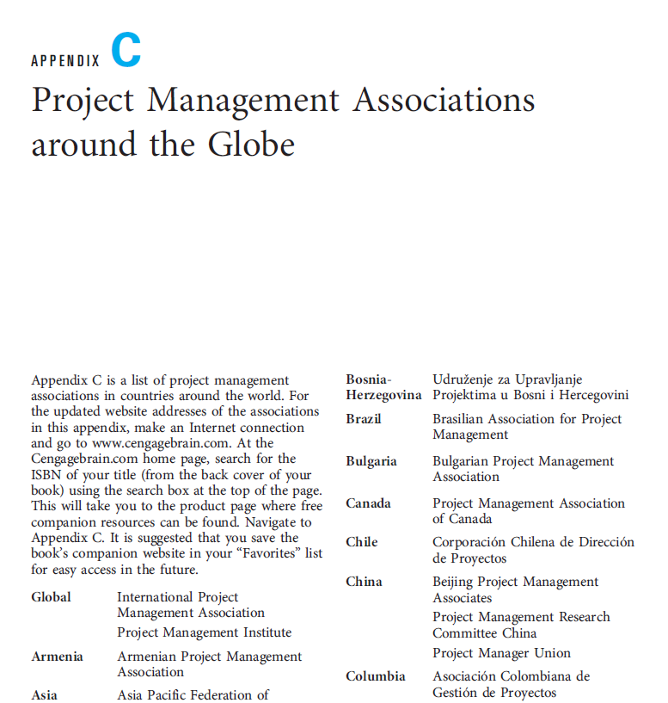
Project Management Associations
Project Management Institute
Global Associations
Worldwide not-for-profit association of practitioners
  ~500,000 members in nearly 200 countries
  ~270 chapters in >80 countries
>30 online communities for collaboration
PMBOK® Guide
PMI Code of Ethics and Professional Conduct
Certifications
www.pmi.org
Links available at www.cengagebrain.com
Notes:
Project Management Associations
The Project Management Institute (PMI) is a premier worldwide not-for-profit association for practitioners in the project management profession and individuals who want to learn more about the profession.
Founded in 1969, PMI is approaching 500,000 members in nearly 200 countries and has about 270 chapters in more than 80 countries. The association has over 30 online communities of practice.
The association has over 30 online communities of practice.
Publishes A Guide to the Project Management Body of Knowledge (PMBOK® Guide), which provides a framework of processes and guidelines for the application of project management concepts, practices, and techniques
Created the PMI Code of Ethics and Professional Conduct, which sets standards and establishes expectations for professional behavior
Offers a certification program that provides the opportunity to earn credentials in various project management disciplines
Additional and current information about the Project Management Institute can be found at http://www.pmi.org.
Many other project management associations exist around the globe.
Appendix C provides a list of approximately 60 such associations.
Website addresses can be found on this book’s student companion website, www.cengagebrain.com,and the link found through a search for the ISBN of Successful Project Management 5e (from the back cover of your book) using the search box at the top of the page.

Slide 30
What are benefits of Project Management?
Student Discussion
Notes:
There are many benefits of implementing project management techniques, as you will see in the upcoming slides. The ultimate benefit is customer satisfaction, but there are a number of other such as satisfaction, job referrals, and enhanced reputation.
What are some of these benefits of project management?

Slide 31
Possible responses to Student Discussion
Customer satisfaction
Complete the project scope in a quality manner, on time, and within budget
Project managers have satisfaction, enhance their reputation, and expand their career opportunities
Project team members contribute to the project's success, expand knowledge, and enhance skills
What are benefits of Project Management?
Notes:
There are many benefits to good project management:
The ultimate benefit of implementing project management techniques is having a satisfied customer—whether you are the customer of your own project, such as remodeling your basement, or a business (contractor) being paid by a customer to perform a project.
Completing the full project scope in a quality manner, on time, and within budget provides a great feeling of satisfaction and possibly referrals for more business.
When they do a good job, project managers benefit from professional satisfaction, enhanced reputation, and expanded career opportunities.
Project team members contribute to the project's success through expanding the knowledge base and enhancing skills.

Slide 32
When projects are successful,
everyone wins!
Notes:
When projects are successful, everyone wins!

Slide 33
Critical Success Factors
Planning and communication are critical to successful project management. They prevent problems from occurring or minimize their impact on the achievement of the project objective when they do occur.
Taking the time to develop a well thought-out plan before the start of the project is critical to the successful accomplishment of any project.
A project must have a clear objective of what is to be accomplished and defined in terms of end product or deliverable, schedule, and budget; and is agreed upon by the customer.
Involve the sponsor or customer as a partner in the successful outcome of the project through active participation during the project.
Achieving customer satisfaction requires ongoing communication with the customer to keep the customer informed and to determine whether expectations have changed.
The key to effective project control is measuring actual progress and comparing it to planned progress on a timely and regular basis and taking any needed corrective action immediately.
After the conclusion of a project, the project performance should be evaluated to learn what could be improved if a similar project were to be undertaken in the future. Feedback should be obtained from the sponsor or customer and the project team.
Learning and understanding the culture and customs of other project participants will demonstrate respect, help build trust, and aid in developing an effective project team; and it is critical for successful global project management.
Notes:
Critical Success Factors
Planning and communication are critical to successful project management. They prevent problems from occurring or minimize their impact on the achievement of the project objective when they do occur.
Taking the time to develop a well thought-out plan before the start of the project is critical to the successful accomplishment of any project.
A project must have a clear objective of what is to be accomplished and defined in terms of end product or deliverable, schedule, and budget, and agreed upon by the customer.
Involve the sponsor or customer as a partner in the successful outcome of the project through active participation during the project.
Achieving customer satisfaction requires ongoing communication with the customer to keep the customer informed and to determine whether expectations have changed.
The key to effective project control is measuring actual progress and comparing it to planned progress on a timely and regular basis and taking any needed corrective action immediately.
After the conclusion of a project, the project performance should be evaluated to learn what could be improved if a similar project were to be done in the future. Feedback should be obtained from the sponsor or customer and the project team.
Learning and understanding the culture and customs of other project participants will demonstrate respect, help build trust, and aid in developing an effective project team; and it is critical for successful global project management.

Slide 34
Summary
A project is an endeavor to accomplish a specific objective through a unique set of interrelated activities and the effective utilization of resources.
The successful accomplishment of the project objective could be constrained by many factors, including scope, quality, schedule, budget, resources, risks, customer satisfaction, and stakeholder support.
The project life cycle has four phases: initiating, planning, performing, and closing the project.
Project management is planning, organizing, coordinating, leading, and controlling resources to accomplish the project objective. The project management process involves two major functions: first establishing a plan and then executing that plan to accomplish the project objective.
Globalization changes the dynamics of a project and adds a layer of complexity that can adversely affect the project outcome if the project participants are not aware of what they can encounter regarding cultural differences and multinational economic transactions.
The Project Management Institute is a premier worldwide not-for-profit association for practitioners in the project management profession.
The ultimate benefit of implementing project management techniques is having a satisfied customer—whether you are the customer of your own project or a business (contractor) being paid by a customer to perform a project.
Notes:
Summary
A project is an endeavor to accomplish a specific objective through a unique set of interrelated tasks and the effective utilization of resources.
The successful accomplishment of the project objective could be constrained by many factors, including scope, quality, schedule, budget, resources, risks, customer satisfaction, and stakeholder support.
The project life cycle has four phases: initiating, planning, performing, and closing the project.
Project management is planning, organizing, coordinating, leading, and controlling resources to accomplish the project objective. The project management process involves two major functions: first establishing a plan and then executing that plan to accomplish the project objective.
Globalization changes the dynamics of a project and adds a layer of complexity that can adversely affect the project outcome if the project participants are not aware of what they can encounter regarding cultural differences and multinational economic transactions.
The Project Management Institute is a premier worldwide not-for-profit association for practitioners in the project management profession.
The ultimate benefit of implementing project management techniques is having a satisfied customer— whether you are the customer of your own project or a business (contractor) being paid by a customer to perform a project.

Slide 35
Chapter Questions
Notes:
The following slides include a number of questions that will test student understanding of the chapter. Each chapter will conclude with questions like these.

Slide 36
Question 1
A project is an endeavor to accomplish a specific objective through a unique set of interrelated tasks and the effective utilization of resources.
Define project.
Notes:
1. Define project.
A project is an endeavor to accomplish a specific objective through a unique set of interrelated tasks and the effective utilization of resources.

Slide 37
Question 2
A project has a well-defined objective—an expected result or product. The objective of a project is usually defined in terms of scope, schedule, and cost. Furthermore, it is expected that the work scope will be accomplished in a quality manner and to the customer’s satisfaction.
For example, to produce 5,000 two-page marketing brochures by July 1 for a cost of $15,000.
Define the term project objective and give some examples.
Notes:
2. Define the term project objective and give some examples.
A project has a well-defined objective—which is an expected result or product. The objective of a project is usually defined in terms of scope, schedule, and cost. Furthermore, it is expected that the work scope will be accomplished in a quality manner and to the customer’s satisfaction.
For example, to produce 5,000 two-page marketing brochures by July 1 for a cost of $15,000.
Be sure to reinforce the necessity to include the scope, schedule, and cost within the objective to clearly communicate what is to be accomplished within a set time frame and budget.

Slide 38
Question 3
The list of resources will be dependent upon the type of project.
Some examples are:
  People
  Equipment
  Money
  Materials
List some examples of resources that are used on a project.
Notes:
3. List some examples of resources that are used on a project.
Resources used in a project will vary depending on the type of project.
Some examples are: people, equipment, money, materials, etc.

Slide 39
Question 4
The customer should be involved throughout the project life cycle.
The customer is the one who is paying for the project. Unsatisfied customers have been known to withhold payments, to deny repeat business, and to spread the word of their dissatisfaction. On the other hand, a satisfied customer will do the opposite of those things.
What role does a customer have during the project life cycle?
Why is it important to satisfy the customer?
Notes:
4. What role does a customer have during the project life cycle? Why is it important to satisfy the customer?
The customer should be involved throughout the project life cycle.
The customer is the one who is paying for the project. Unsatisfied customers have been known to withhold payments, never call you again for repeat business, and spread the word of their dissatisfaction. On the other hand, a satisfied customer will do the opposite of those things.

Slide 40
Question 5
Many aspects can have some degree of uncertainty, such as the schedule or the budget.
  An unexpected snowstorm may delay a highway construction project.
  Increased lumber rates may increase the cost of building a new home.
Not everything in a project can be planned, scheduled, or budgeted.
What aspects of a project might involve some degree of uncertainty? Why?
Notes:
5. What aspects of a project might involve some degree of uncertainty? Why?
Many aspects can have some degree of uncertainty, such as the schedule or the budget.
An unexpected snowstorm may delay a highway construction project.
Increased lumber rates may increase the cost of building a new home.
Not everything in a project can be planned, scheduled, or budgeted.

Slide 41
Question 6
The scope of a project is all the work that must be done in order to satisfy the customer that the deliverables meet the requirements or acceptance criteria agreed upon at the onset of the project.
The cost of a project is the amount the customer has agreed to pay for acceptable project deliverables. The project cost is based on a budget that includes an estimate of the costs associated with the various resources that will be used to accomplish the project.
The schedule for a project is the timetable that specifies when each activity should start and finish. The project objective usually states the time by which the project scope must be completed in terms of a specific date agreed upon by the customer and the individual or organization performing the work.
Customer Satisfaction is the level to which the customer is pleased with the end result of the project.
The objective of any project is to complete the scope within budget by a certain time to the customer’s satisfaction. Any of these four factors can put limitations on the final product.
Define scope, schedule, cost, and customer satisfaction.
Why are these considered to be constraints?
Notes:
6. Define scope, schedule, cost, and customer satisfaction. Why are these considered to be constraints?
The scope of a project is all the work that must be done in order to satisfy the customer that the deliverables meet the requirements or acceptance criteria agreed upon at the onset of the project.
The cost of a project is the amount the customer has agreed to pay for acceptable project deliverables. The project cost is based on a budget that includes an estimate of the costs associated with the various resources that will be used to accomplish the project.
The schedule for a project is the timetable that specifies when each activity should start and finish. The project objective usually states the time by which the project scope must be completed in terms of a specific date agreed upon by the customer and the individual or organization performing the work.
Customer Satisfaction is the level to which the customer is pleased with the end result of the project.
The objective of any project is to complete the scope within budget by a certain time to the customer’s satisfaction. Any of these four factors can put limitations on the final product.

Slide 42
Question 7
The first phase, the initiating phase, is when projects are identified and selected. They are then authorized, using a document referred to as a project charter.
The second phase is the planning phase and includes defining the project scope, identifying resources, developing a schedule and budget, and identifying risks, all of which make up the baseline plan for doing the project work.
The third phase, the performing phase, the project plan is executed and work tasks are carried out to produce all the project deliverables and to accomplish the project objective. During this phase, the project progress is monitored and controlled to assure the work remains on schedule and within budget, the scope is fully completed according to specifications, and all deliverables meet acceptance criteria. Also, any changes need to be documented, approved, and may be incorporated into an updated baseline plan.
The final phase of the project life cycle is the closing phase, project evaluations are conducted, lessons learned are identified and documented to help improve performance on future projects, and project documents are organized and archived.
List and describe the main phases of the project life cycle.
Notes:
7. List and describe the main phases of the project life cycle.
The first phase, the initiating phase, is when projects are identified and selected. They are then authorized, using a document referred to as a project charter.
The second phase of the project life cycle is the planning phase and includes defining the project scope, identifying resources, developing a schedule and budget, and identifying risks, all of which make up the baseline plan for doing the project work.
The third phase, the performing phase, the project plan is executed and work tasks are carried out to produce all the project deliverables and to accomplish the project objective. During this phase, the project progress is monitored and controlled to assure the work remains on schedule and within budget, the scope is fully completed according to specifications, and all deliverables meet acceptance criteria. Also, any changes need to be documented, approved, and may be incorporated into an updated baseline plan.
The final phase of the project life cycle is the closing phase, project evaluations are conducted, lessons learned are identified and documented to help improve performance on future projects, and project documents are organized and archived.

Slide 43
Question 8
Establish project objective -- clearly define the project objective and have it agreed upon by the sponsor or customer.
Define scope -- include customer requirements, define the major work tasks or elements, as well as provide a list of deliverables and associated acceptance criteria that can be used to verify that the work and deliverables meet specifications.
Create a work breakdown structure -- divide and subdivide the project scope into pieces or work packages.
Assign responsibility - identify the person or organization responsible for each work item in the work breakdown structure.
Define the specific activities -- develop the list of detailed activities that need to be performed for each work package to produce any required deliverables.
Sequence activities -- graphically portray the activities in a network diagram to display the sequence and dependent relationships of the detailed activities.
Estimate activity resources -- determine which types and skills or expertise of resources and how many of each resource are needed for each activity with consideration of the availability of the resources.
Estimate activity durations -- make a time estimate for how long it will take to complete each activity, based on the estimate of the resources that will be applied.
Develop the project schedule -- develop the overall project schedule, including when each activity is expected to start and finish, as well as the latest times that each activity must start and finish in order to complete the project by the project required completion date.
Estimate activity costs -- determine the costs for the types and quantities of resources estimated for each activity using the appropriate labor cost rate or unit cost for each type of resource.
Determine the budget -- aggregate the cost estimates for each activity.
List and describe the steps required to develop a baseline plan.
Notes:
8. List and describe the steps required to develop a baseline plan.
Establish project objective– clearly define the project objective and have it agreed upon by the sponsor or customer.
Define scope— include customer requirements, define the major work tasks or elements, as well as provide a list of deliverables and associated acceptance criteria that can be used to verify that the work and deliverables meet specifications.
Create a work breakdown structure (WBS)— divide and subdivide the project scope into pieces or work packages.
Assign responsibility— identify the person or organization responsible for each work item in the work breakdown structure.
Define the specific activities— develop the list of detailed activities that need to be performed for each work package to produce any required deliverables.
Sequence activities— graphically portray the activities in a network diagram to display the sequence and dependent relationships of the detailed activities.
Estimate activity resources– determine which types and skills or expertise of resources and how many of each resource are needed for each activity with consideration of the availability of the resources.
Estimate activity durations– make a time estimate for how long it will take to complete each activity, based on the estimate of the resources that will be applied.
Develop the project schedule– develop the overall project schedule, including when each activity is expected to start and finish, as well as the latest times that each activity must start and finish in order to complete the project by the project required completion date.
Estimate activity costs— determine the costs for the types and quantities of resources estimated for each activity using the appropriate labor cost rate or unit cost for each type of resource.
Determine the budget– aggregate the cost estimates for each activity.

Slide 44
Question 9
A manager must monitor progress to ensure that everything is going according to plan. It is also necessary to measure actual progress and compare it to planned progress.
If at any time during the project the comparison of actual progress to planned progress reveals that the project is behind schedule, overrunning the budget, or not meeting the technical specifications, corrective action must be taken to get the project back on track within the scope, schedule, and budget constraints of the project objective. These actions include adding or changing resources to make up time and get back on schedule.
Why must a manager monitor the progress of a project?
What can be done if a project is not proceeding according to plan?
Notes:
9. Why must a manager monitor the progress of a project? What can be done if a project is not proceeding according to plan?
A manager must monitor progress to ensure that everything is going according to plan. It is also necessary to measure actual progress and compare it to planned progress.
If at any time during the project the comparison of actual progress to planned progress reveals that the project is behind schedule, overrunning the budget, or not meeting the technical specifications, corrective action must be taken to get the project back on track within the scope, schedule, and budget constraints of the project objective. These actions include adding or changing resources to make up time and get back on schedule.

Slide 45
Question 10
Answers to this question will vary depending on the student.
Check responses to be sure they include the individuals and entities involved in, or who may influence, or may be affected by a project and what stake each had in the project.
Think of a project in which you were involved and identify the stakeholders and what “stake” each had in the project.
Notes:
10. Think of a project in which you were involved and identify the stakeholders and what “stake” each had in the project.
Answers to this question will vary depending on the student. Check responses to be sure they include the individuals and entities involved in, or who may influence, or may be affected by a project and what stake each had in the project.

Slide 46
Question 11
Global projects have several unique influencing factors such as currency fluctuations and exchange rates, country-specific work codes and regulations, corporate joint ventures and partnerships creating entities with a presence and facilities in multiple countries, political relations between countries, and availability of high-demand workforce skills.
Globalization changes the dynamics of the project and adds a layer of complexity, which can adversely affect the project outcome if the project participants are not aware of what they might encounter regarding cultural differences and multinational economic transactions.
Describe how a global project can be more complex than a project performed within just one country.
How might these elements affect the successful outcome of the global project?
Notes:
11. Describe how a global project can be more complex than a project performed within just one country. How might these elements affect the successful outcome of the global project?
Global projects have several unique influencing factors such as currency fluctuations and exchange rates, country-specific work codes and regulations, corporate joint ventures and partnerships creating entities with a presence and facilities in multiple countries, political relations between countries, and availability of high-demand workforce skills.
Globalization changes the dynamics of the project and adds a layer of complexity, which can adversely affect the project outcome if the project participants are not aware of what they might encounter regarding cultural differences and multinational economic transactions.

Slide 47
Question 12
The ultimate benefit of implementing project management techniques is having a satisfied customer.
Completing the full project scope in a quality manner, on time, and within budget provides a great feeling of satisfaction.
It could lead to additional business.
Successful projects can expand career opportunities.
A feeling of satisfaction from being on a winning team.
An expansion of knowledge, enhancement of skills, and preparation of more complicated projects.
When projects are successful, everybody wins!
List some benefits of using project management techniques.
Notes:
12. List some benefits of using project management techniques.
The ultimate benefit of implementing project management techniques is having a satisfied customer.
Completing the full project scope in a quality manner, on time, and within budget provides a great feeling of satisfaction.
It could lead to additional business.
Successful projects can expand career opportunities.
It can lead to a feeling of satisfaction from being on a winning team.
Project management techniques can lead to an expansion of knowledge, enhancement of skills, and preparation of more complicated projects.
When projects are successful, everybody wins!

Slide 48
Question 13
Answers to this question will vary depending on the student.
Responses should include the definition of a project, an endeavor to accomplish a specific objective through a unique set of interrelated tasks and the effective utilization of resources.
Consider a project in which you are currently involved (or in which you have been involved recently).
Describe the objectives, scope, schedule, cost, and any assumptions made.
Where are you in the project life cycle?
Does this project have a baseline plan? If yes, describe it. If not, create it.
Are you or is anyone else monitoring the progress of the project? If so, how? If not, how could you do so?
Describe some unexpected circumstances that could jeopardize the success of the project.
Describe the anticipated benefits of the project.
Notes:
13. Consider a project in which you are currently involved (or in which you have been involved recently).
Describe the objectives, scope, schedule, cost, and any assumptions made.
Where are you in the project life cycle?
Does this project have a baseline plan? If yes, describe it. If not, create it.
Are you or is anyone else monitoring the progress of the project? If so, how? If not, how could you do so?
Describe some unexpected circumstances that could jeopardize the success of the project.
Describe the anticipated benefits of the project.
Answers to this question will vary depending on the student.
Check responses to be sure students include the definition of a project, an endeavor to accomplish a specific objective through a unique set of interrelated tasks and the effective utilization of resources.

Slide 49
Project Management
Project Management Institute
Executive Planet TM
Internet Exercises
Notes:
Internet Exercises
The Internet Exercises can be a very valuable part of this course. Assign these exercises to your students as homework or complete them with students in a computer lab. They help to reinforce the concepts in the chapter and expose the students to additional resources that are available through the Internet.

Slide 50
Internet Exercises
Examination of broad field of project management will reinforce the growth of the project management field.
Many organizations are realizing the value of employees having project management training and certifications.
Exploration of the project management information provides information about additional education or certifications.
Using your favorite Web search engine, perform a search for “project management.”
Do several additional Web searches by adding, after the words “project management,” some of the key words listed in this chapter.
Check out the PMI website for information regarding memberships, certification, education, and publications.
Search for PMI Global Congresses and Events.
Executive PlanetTM provides valuable tips on business etiquette, customs, and protocol for doing business worldwide. Go to the organization’s website and explore the business culture guides for three different countries.
Notes:
Internet Exercises
This slide lists a number of different ideas for Internet exercises, which can be a very valuable part of this course.
Examination of broad field of project management will reinforce the growth of the project management field.
Many organizations are realizing the value of employees having project management training and certifications.
Exploration of the project management information might motivate students to seek additional education or certifications.

Slide 51
A Not-For-Profit Organization
Case Study 1
Notes:
Case Study #1: A Not-For-Profit Organization
This case study involves a meeting of the officers of the student community service organization that collects, buys, and distributes food for the needy. Their funds are almost exhausted and the demand for service is growing.
Group Activity
Many community service organizations are facing the same issues as this student community service organization: they need additional funds for operation, more volunteers, and more donations to fund activities and operations.
Having students learn about how not-for-profit organizations plan their projects and complete funding and donation requests will provide a rich learning opportunity and insight into project management that can only be gained through experience and direct observation.

Slide 52
Case Study 1
Question 1
They need to find a way to get more funds.
They need more volunteers.
They need more space.
Some respondents may point out that they do not have a project plan for how to spend their current funding and need a project plan for their current work.
What are the needs that have been identified?
Notes:
1. What are the needs that have been identified?
They need to find a way to get more funds.
They need more volunteers.
They need more space.
Some students may point out that they do not have a project plan for how to spend their current funding and need a project plan for their current work.

Slide 53
Case Study 1
Question 2
At this point they don’t all agree on the objective.
What is the project objective?
Notes:
2. What is the project objective?
At this point they don’t all agree on the objective.

Slide 54
Case Study 1
Question 3
You must always be careful when making assumptions. However, the following statements are made in the case study. Some may or may not actually be true.
  They will run out of funds in two months.
  The local government is not able to provide additional funds.
  The demand is increasing.
  They need more space and more volunteers.
  They get some food donations, but maybe not on a regular basis.
What assumptions, if any, should be made regarding the project to be undertaken?
Notes:
3. What assumptions, if any, should be made regarding the project to be undertaken?
You must always be careful when making assumptions. However, the following statements are made in the case study. Some of these may not actually be true.
They will run out of funds in two months.
The local government is not able to provide additional funds.
The demand is increasing.
They need more space and more volunteers.
They get some food donations, but maybe not on a regular basis.

Slide 55
Case Study 1
Question 4
If the statements in the story are true, then the risk of not succeeding with this project is that the organization will have to shut down and members of the community in need of food will no longer have this student community service organization as a source of assistance.
What are the risks involved in the project?
Notes:
4. What are the risks involved in the project?
If the statements in the story are true, then the risk of not succeeding with this project is that the organization will have to shut down and members of the community in need of food will no longer have this student community service organization as a source of assistance.

Slide 56
E-Commerce For A Small Supermarket
Case Study 2
Notes:
Case Study #2: E-Commerce for a Small Supermarket
This case study involves a small supermarket in a rural town with a large and growing elderly population. The owners are discussing the possibility of putting their operation online.
Group Activity
Have two students act out the parts of Matt and Grace. These students should role play the interaction between the consultant and Matt and Grace. Be sure to have the students focus on the needs identification of the potential project for the store.
Optional Activity
Have course participants, individually or in small groups, contact a business that went ‘‘online’’ or developed an app and ask the business what led it to that decision and if the project met its initial expectations.

Slide 57
Case Study 2
Question 1
They believe that putting their grocery store on-line will bring increased sales.
They also have a need to repave the parking lot.
What are the needs that have been identified?
Notes:
1. What are the needs that have been identified?
They believe that putting their grocery store on-line will bring increased sales.
They also have a need to repave the parking lot.

Slide 58
Case Study 2
Question 2
At this point, Matt and Grace have not decided.
They have an idea to create an online ordering site, create an app for tablets or phones, or just have a page with a picture of the market and them.
What is the project objective?
Notes:
2. What is the project objective?
At this point, Matt and Grace have not decided.
They have an idea to create an online ordering site, create an app for tablets or phones, or just have a page with a picture of the market and them.

Slide 59
Case Study 2
Question 3
They must list, and possibly test, some of their assumptions. You must always be careful when making assumptions. However, the following statements are made in the case study. Some may or may not actually be true.
  They can increase sales by putting their operation online.
  There is a demand for online services.
  The benefits of doing this will outweigh the costs.
Matt and Grace also need to determine the motivations of the consultant. They need to find out if the consultant is selling services for web development or if the consultant is a technical assistance specialist that will provide well-informed suggestions to Matt and Grace.
What are some things Matt and Grace should do before they talk with the consultant?
Notes:
3. What are some things Matt and Grace should do before they talk with the consultant?
They must list, and possibly test, some of their assumptions. You must always be careful when making assumptions. However, the following statements are made in the case study. Some may not actually be true.
They can increase sales by putting their operation online.
There is a demand for online services.
The benefits of doing this will outweigh the costs.
Matt and Grace also need to determine the motivations of the consultant. They need to find out if the consultant is selling services for web development, or if the consultant is a technical assistance specialist that will provide well-informed suggestions to Matt and Grace.

Slide 60
Case Study 2
Question 4
An honest consultant would determine the feasibility of this project.
It might very well not be feasible, but it is very possible that the consultant will just give them a price for building the system.
What should the consultant tell Matt and Grace?
Notes:
4. What should the consultant tell Matt and Grace?
An honest consultant would determine the feasibility of this project.
It might very well not be feasible, but it is very possible that the consultant will just give them a price for building the system.

